Slide 1
3.Instruction Hazards

Slide 2
3.1 Overview
Whenever the stream of instructions supplied by the instruction fetch unit is interrupted, the pipeline stalls - cache miss
It can also be caused for Branch instructions

Slide 3
3.2 Unconditional Branches

Slide 4
Branch Timing
Branch penalty: The time lost as a result of a branch instruction
- Reducing the penalty- requires the branch address to be computed earlier in the pipeline
Fetch unit has dedicated h/w to identify a branch instruction

Slide 5
Instruction Queue and Prefetching
Instruction fetch unit
Instruction queue
F : Fetch
instruction
D : Dispatch/
E : Ex
ecute
W : Write
Decode
instruction
results
unit
Figure 8.10. Use of an instruction queue in the hardware organization of Figure 8.2b.

Slide 6
3.3 Conditional Branches
A conditional branch instruction introduces the added hazard caused by the dependency of the branch condition on the result of a preceding instruction.
The decision to branch cannot be made until the execution of that instruction has been completed.

Slide 7
Delayed Branch
The location following a branch instruction is called a branch delay slot
Delayed branching minimizes the penalty
The instructions in the delay slots are always fetched.
Therefore, we would like to arrange for them to be fully executed whether or not the branch is taken.
The objective is to place useful instructions in these slots or with NOP.
The effectiveness of the delayed branch approach depends on how often it is possible to reorder instructions.

Slide 8
Delayed Branch
LOOP
Shift_left
R1
Decrement
R2
Branch=0
LOOP
NEXT
Add
R1,R3
(a) Original program loop
LOOP
Decrement
R2
Branch=0
LOOP
Shift_left
R1
NEXT
Add
R1,R3
(b) Reordered instructions
Figure 8.12. Reordering of instructions for a delayed branch.

Slide 9
Delayed Branch
T
ime
Clock c
ycle
1
2
3
4
5
6
7
8
Instruction
Decrement
F
E
Branch
F
E
Shift (delay slot)
F
E
Decrement (Branch tak
en)
F
E
Branch
F
E
Shift (delay slot)
F
E
Add (Branch not tak
en)
F
E
Figure 8.13. Execution timing showing the delay slot being filled
during the last two passes through the loop in Figure 8.12.

Slide 10
Branch Prediction
To predict whether or not a particular branch will be taken.
Simplest form: assume branch will not take place and continue to fetch instructions in sequential address order.
Until the branch is evaluated, instruction execution along the predicted path must be done on a speculative basis.
Speculative execution: instructions are executed before the processor is certain that they are in the correct execution sequence.
Need to be careful so that no processor registers or memory locations are updated until it is confirmed that these instructions should indeed be executed.

Slide 11
Incorrectly Predicted Branch
T
ime
Clock cycle
1
2
3
4
5
6
Instruction
I
1
(Compare)
F
1
D
1
E
1
W
1
I
2
(Branch>0)
F
2
D
2
/P
2
E
2
I
3
F
3
D
3
X
I
4
F
4
X
I
k
F
k
D
k
Figure 8.14. Timing when a branch decision has been incorrectly predicted
as not taken.

Slide 12
Branch Prediction
Better performance can be achieved if we arrange for some branch instructions to be predicted as taken and others as not taken.
Use hardware to observe whether the target address is lower or higher than that of the branch instruction.
Let compiler include a branch prediction bit.
So far the branch prediction decision is always the same every time a given instruction is executed – static branch prediction.

Slide 13
Dynamic Branch Prediction
Processor h/w assesses the likelihood of a given branch being taken by keeping track of branch decisions every time that instruction is executed
Algorithms
2 state algorithm
4 state algorithm

Slide 14
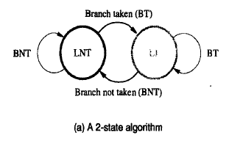
Two state algorithm
2 states
LT: Branch is likely to be taken
LNT: Branch is likely not to be taken
Starts with LNT
When branch is taken – moves to LT
Problem: Next time the loop is executed, expecting that loop executes for more than once, leads to wrong prediction

Slide 15
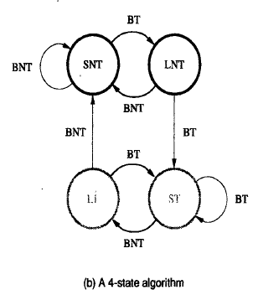
Four state algorithm
4 states
ST: Strongly likely to be taken
LT: Likely to be taken
LNT: Likely not to be taken
SNT: Strongly likely not to be taken
Starts with LNT
When branch is taken – moves to ST , otherwise to SNT
In SNT if branching happens, it changes to LNT.
Again when branching happens only it changes to ST
Use Branch Target Buffer(BTB) to get the branch target address

